Slide 1

React.js
Course Introduction
SoftUni Team
Technical Trainers
Software University
https://softuni.bg/

Slide 2

Table of Contents
Course Overview
Course Objectives
Course Topics
Trainers Team
Exams and Evaluation
Learning Resources

Slide 3
Have a Question?
sli.do
#js-web

Slide 4












SoftUni Diamond Partners

Slide 5


Educational Partners

Slide 6

React.js

Slide 7
Course Objectives
The React.js Fundamentals course provides
Fundamental understanding of JSX and React
Covers component-based architecture
Establishes Immutable UI concepts
What is NOT covered?
JavaScript basics and REST communication
Optimization and Web Components
7

Slide 8
Not for Absolute Beginners
The "React.js" course is NOT for absolute beginners
Requirements
HTML & JS (ES 2016) - intermediate level
Our HTML & CSS Mini Course can help you
Computer English - entry level
8

Slide 9
Course Topics
React.js overview, JSX syntax
Components, state, props
Events, Lifecycle, CSS Modules, Fetching Data
Forms
Routing
React Hooks and Authentication
Advanced Techniques
9

Slide 10

The Team

Slide 11
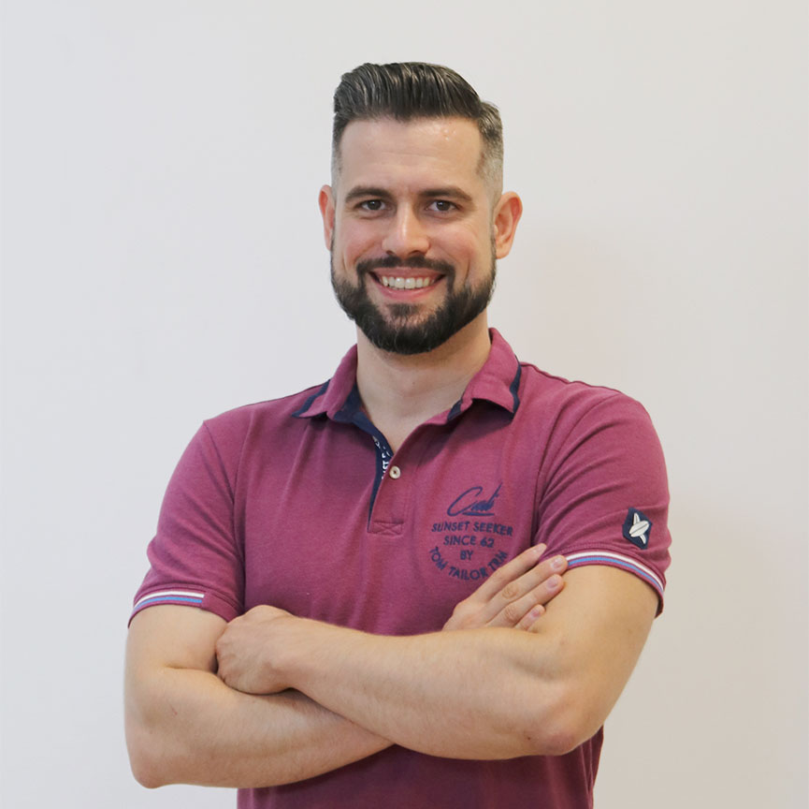
Ivaylo Papazov
Senior Software Engineer at Payhawk
Trainer at SoftUni
Experience with JS, React, Node.js, MongoDB
6+ years professional experience

Slide 12

Course Details
Schedule

Slide 13
JS Web Module Timeline
COMPLETED
JS Back-end
Start: 16. May 2022
Exam: 25. Jun 2022
16.
25.
6 weeks
2 times per week
May
Jun
ReactJS
Start: 27. Jun 2022
Project Defense: 13. Aug 2022
27.
13.
&
21.
6 weeks
2 times per week
Jun
Jul
Aug
Retakes
JS Back-end: 18. Aug 2022
ReactJS: 21. Aug 2022
August

Slide 14

Training Duration
Lessons: ~30 hours (onsite + videos)
Practical Workshop (in class): ~30 hours
Project Defense: 20 minutes
Defense date: 13 Aug 2022
Retake defense date: 21 Aug 2022

Slide 15


Project Assignment
The three best projects will win a discount for the next course (professional / open program)
First place – 80% of the price
Second place – 50% of the price
Third place – 30% of the price
80%
50%
30%

Slide 16
Theoretical Exam
20 questions for 30 minutes
Multiple-choice
English
Automated quiz system
Available online
You can submit your answers just one time

Slide 17
Course Scoring
Project Defense grade:
Theory grade:
SoftUni Certificate: 5.00 from Project Defense
CPE Certificate: 3.00 average from Project Defense + Theory
Project Defense
100 %
Theoretical Exam
100 %
17

Slide 18

Learn to Search Online
The course assignments require searching online
This is an important part of the learning process
Some exercises intentionally have no hints
Learn to find solutions!
Software development includes everyday searching and learning
No excuses, just learn to study!
Developers learn new technologies, tools, languages every day!

Slide 19




Course Web Site, Forum and FB Group
Official web site:
Official discussion forum:
Official Facebook group:
Official SoftUni JavaScript Community:
https://softuni.bg/trainings/3727/reactjs-june-2022
softuni.bg/forum/categories/107/
https://www.facebook.com/groups/ReactJSJune2022
facebook.com/groups/SoftUniJavaScriptCommunity/

Slide 20
Questions?
Notes:
20

Slide 21
Trainings @ Software University (SoftUni)
Software University – High-Quality Education, Profession and Job for Software Developers
softuni.bg, about.softuni.bg
Software University Foundation
softuni.foundation
Software University @ Facebook
facebook.com/SoftwareUniversity
Software University Forums
forum.softuni.bg
21
Notes:
21

Slide 22

License
This course (slides, examples, demos, exercises, homework, documents, videos and other assets) is copyrighted content
Unauthorized copy, reproduction or use is illegal
© SoftUni – https://about.softuni.bg
© Software University – https://softuni.bg
Notes:
22

